Slide 1
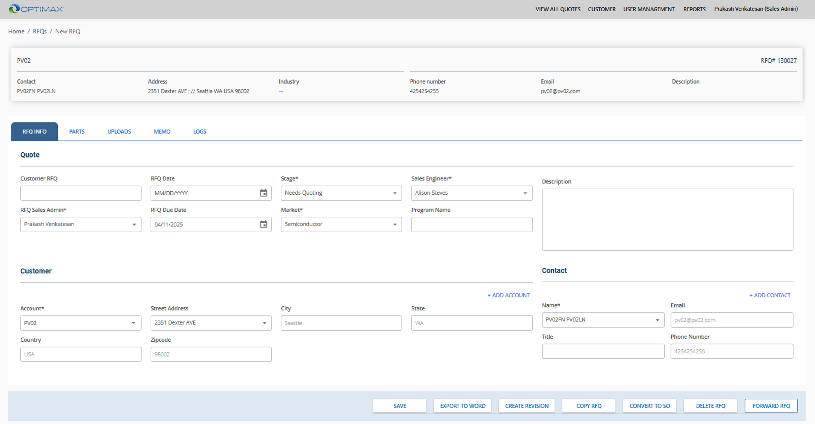
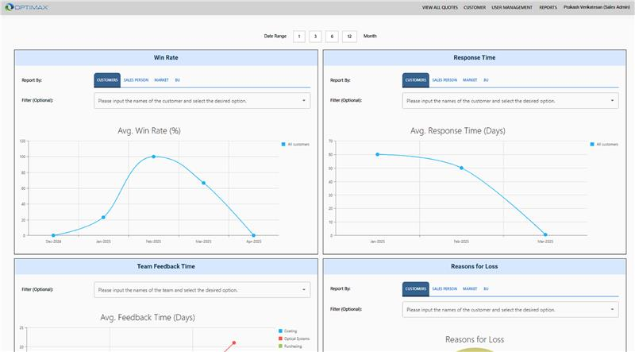
Optimax – Quote to Order
Business Need
Optimax, a world-class manufacturer of precision optics, need assistance finding a software solution for their sales, quoting, and order process. Affirma worked with Optimax to evaluate if existing SaaS products could meet their needs or if a custom-built solution was needed.
Outcomes
Determined that custom-built software solution was best to meet requirements
Proposal Tracking- Track requests for quotes and any relevant information for turning into a quote and order.
ERP Integration – Synchronization with existing EPICOR ERP for Customers, Contacts & Parts.
Multi-team quote – Invite different departments to individual quotes for incorporating pricing with ability to upload optic diagrams and inter-team communications
Orders – Upon winning contract, convert RFQs into Sales Order in EPICOR
Sales Pipeline- Reporting for sales performance based on historical RFQs & Sales Orders.
HubSpot Integration – Push RFQs and SO details into HubSpot for larger sales team reporting

